Slide 1
Supporting Infants & Toddlers with Multiple Disabilities, Including Combined Vision & Hearing Loss (Part 2)
Lisa Poff, Program Coordinator
Barbara Purvis, M.Ed., Presenter
May 17, 2016

Slide 2
Outcomes
Increased knowledge of
Risk factors associated with combined vision and hearing loss
Impact of combined vision and hearing loss on early development
Key evidence-based practices to improve developmental outcomes
Accommodations & adaptations that promote access to & participation in learning experiences
Strategies to promote movement, exploration, communication, concept development & social interaction

Slide 3
DEC Recommended Practices (1 of 4)
Assessment
A3: Practitioners use assessment materials and strategies that are appropriate for the child’s age and level of development and accommodate the child’s sensory, physical, communication, cultural, linguistic, social and emotional characteristics
Family
F2: Practitioners provide the family with up-to-date, comprehensive and unbiased information in a way that the family can understand and use to make informed choices and decisions
F8: Practitioners provide the family of a young child who has or is at risk for developmental delay/disability, and who is a dual language learner, with information about the benefits of learning in multiple languages for the child’s growth and development

Slide 4
DEC Recommended Practices (2 of 4)
Environment
E3: Practitioners work with the family and other adults to modify and adapt the physical, social and temporal environments to promote each child’s access to and participation in learning activities
E4: Practitioners with families and other adults to identify each child’s needs for assistive technology to promote access to and participation in learning experiences
E6: Practitioners create environments that provide opportunities for movement and regular physical activity to maintain or improve fitness, wellness and development across domains.

Slide 5
DEC Recommended Practices (3 of 4)
Instruction
INS1: Practitioners, with the family, identify each child’s strengths, preferences, and interests to engage the child in active learning
INS2: Practitioners, with the family, identify skills to target for instruction that help a child become adaptive, competent, socially connected, and engaged and that promote learning in natural and inclusive environments
INS4: Practitioners plan for and provide the level of support, accommodations, and adaptations needed for the child to access, participate, and learn within and across activities and routines.
INS5: Practitioners embed instruction within and across routines, activities and environments to provide contextually relevant learning opportunities
INS6: Practitioners use systematic instructional strategies with fidelity to teach skills and to promote child engagement and learning

Slide 6
DEC Recommended Practices (4 of 4)
Interaction
INT1: Practitioners promote the child’s social-emotional development by observing, interpreting, and responding contingently to the range of the child’s emotional expressions.
INT2: Practitioners promote the child’s social development by encouraging the child to initiate or sustain positive interactions with other children and adults during routines and activities through modeling, teaching, feedback, or other types of guided support.
INT3: Practitioners promote the child’s communication development by observing, interpreting, and responding contingently and providing natural consequences for the child’s verbal and non-verbal communication and by using language to label and expand on the child’s requests, needs, preferences, or interests.
INT4: Practitioners promote the child’s cognitive development by observing, interpreting, and responding intentionally to the child’s exploration, play, and social activity by joining in and expanding on the child’s focus, actions, and intent.
INT5: Practitioners promote the child’s problem-solving behavior by observing, interpreting, and scaffolding in response to the child’s growing level of autonomy and self-regulation.

Slide 7
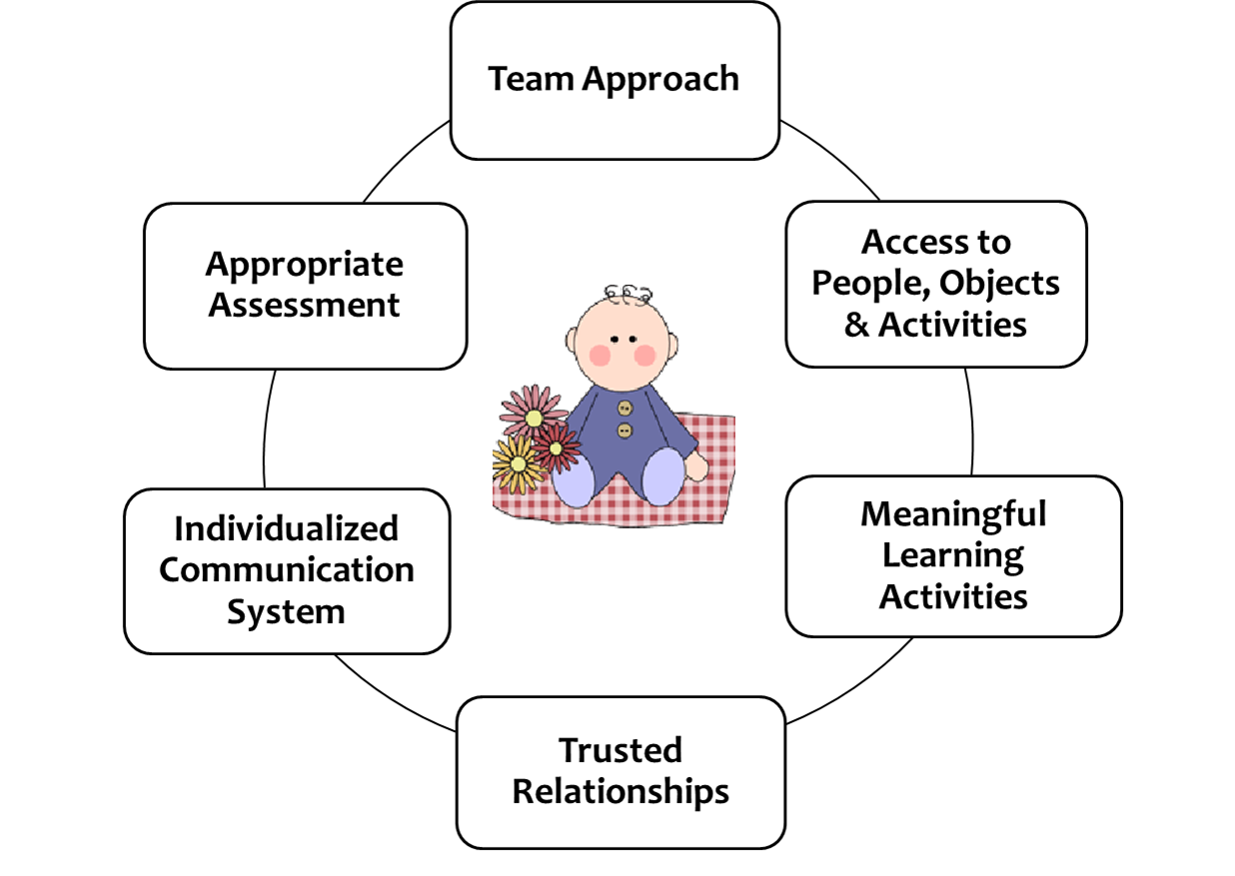
Building a Foundation for Learning
Six concepts circled around a clip art of a baby. Concepts: Team Approach, Appropriate Assessment, Individualized Communication System, Trusted Relationship, Meaningful Learning Activities, Access to People, Objects & Activities.

Slide 8
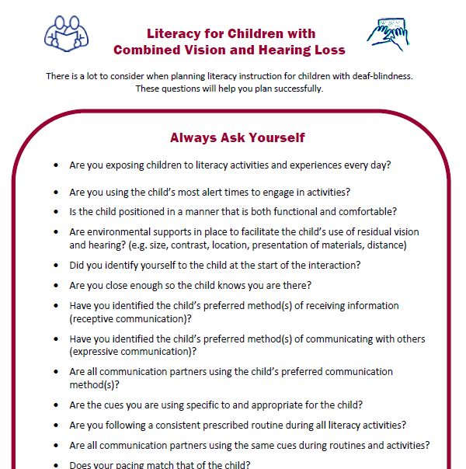
Tips for Successful Intervention

Slide 9
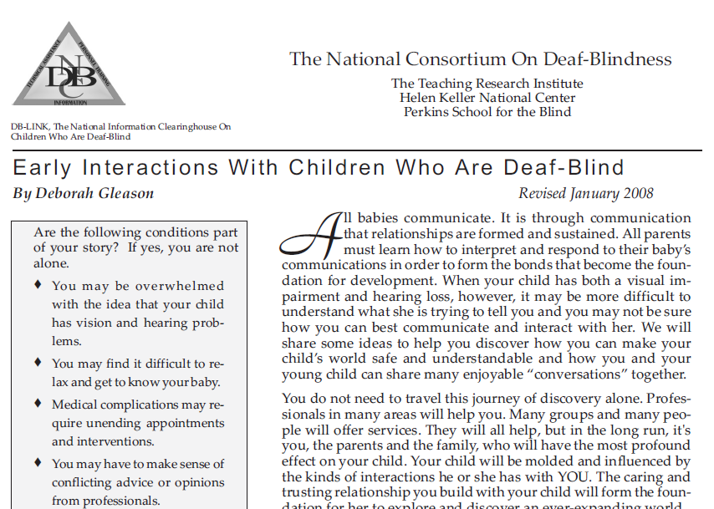
Early Interactions with Children who are Deaf-Blind

Slide 10
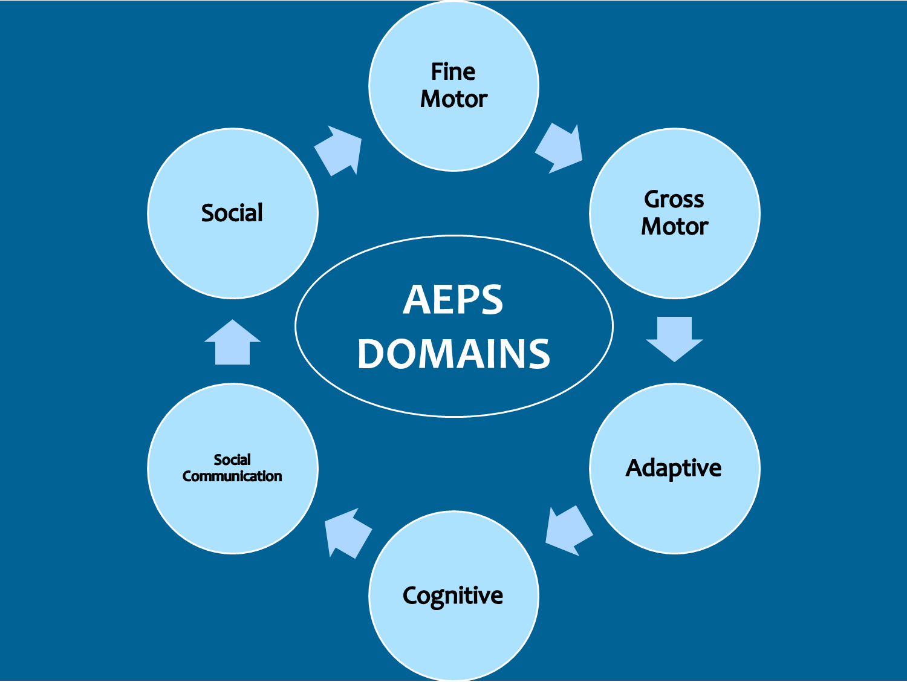
AEPS Domains – Complete
Six circles arranged in a circle around “AEPS Domains”, with arrows in between them pointing clockwise. The six circles say Fine Motor, Gross Motor, Adaptive, Cognitive, Social Communication, and Social.

Slide 11
Developing Outcomes
Key Components
Priorities and Preferences
Functionality
Generality
Ease of Integration
Developmental Appropriateness
(Chen, 2014)
Notes:
Have HIGH EXPECTATIONS!
Avoid the “He’s too this…” or “She’s too that…” trap
Outcomes based on progressing through a set of sequential skills aren’t likely to work with these children
Child and family priorities & preferences – important EI practice – especially important for this population
Always think about what you are doing from the child’s perspective
Is it functional – no time for skills for skills sake – has to be relevant
Need to think about how to generalize from the get-go; limited access & experiences present a challenge
These families are dealing with a lot – if it’s not easy to integrate into their lives it won’t happen
Often make mistake of jumping too far ahead (e.g. communication methods); complicated children need careful intervention planning
Means re-thinking some basic assumptions about early childhood learning principles (e.g. stimulate, stimulate, stimulate)

Slide 12
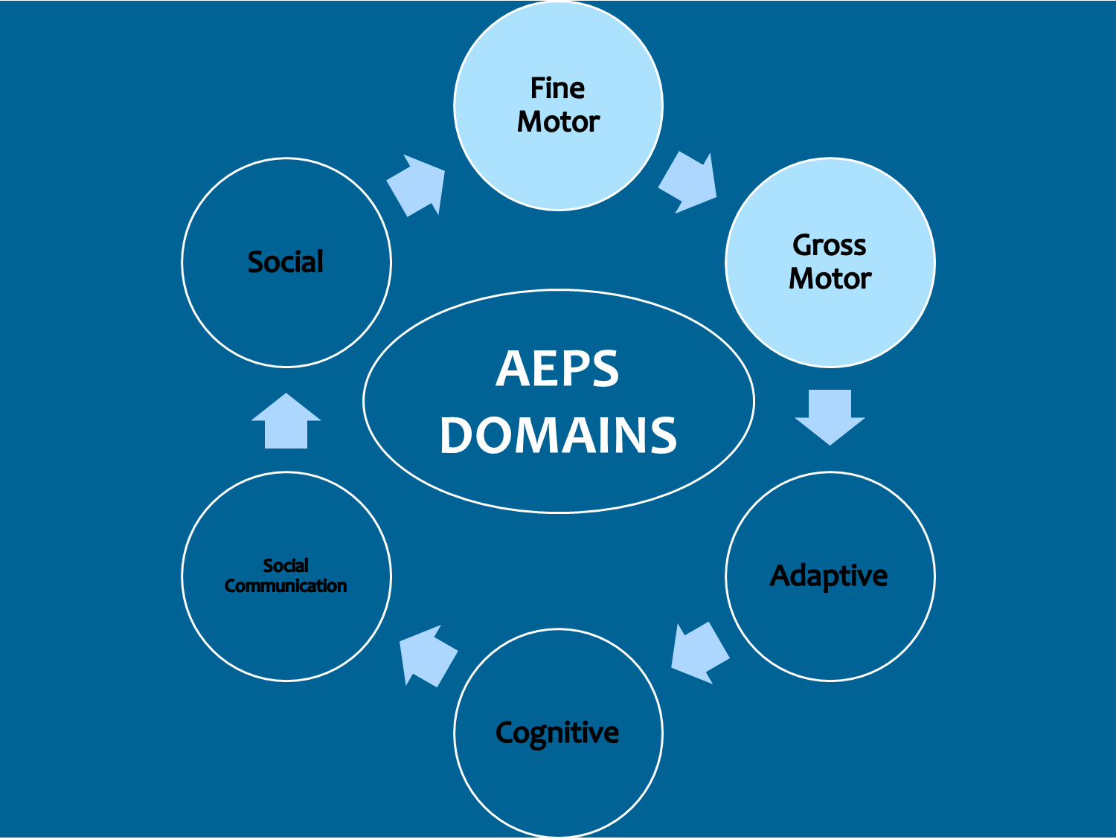
AEPS Domains- Fine Motor and Gross Motor
Six circles arranged in a circle around “AEPS Domains”, with arrows in between them pointing clockwise. The six circles say Fine Motor, Gross Motor, Adaptive, Cognitive, Social Communication, and Social. Fine Motor and Gross Motor are highlighted.

Slide 13
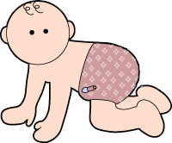
Impact on Motor Skills
“Bubble” environment
Body awareness
Space awareness
Reaching and movement
Locomotion
Notes:
The world can be a scary place!

Slide 14
How can we help improve motor skills?
Provide safety, security, predictability
Create responsive environments
Use active learning principles & practices
Expand experiences & environments thoughtfully

Slide 15
Safety – Security – Predictability
Pay extra attention to basic safety practices
Provide safe base
Familiarity fosters security
Sense of control
Willingness to try new things
Notes:
A cautionary word
Developmental need as children learn to walk, crawl – our kids need it longer

Slide 16
Responsive Environments
Encourage discovery and practice
Offer immediate feedback
Provide sense of familiarity and control
  Examples
    Lilli Nielsen’s “Little Room”
    Resonance board
    Stay put play spaces
    Create your own!

Slide 17
Active Learning Principles & Practices
Encourage movement & self-directed exploration
Maximize engagement & participation
Facilitate self-directed exploration
Build on child preferences
Encourage communication
Promote memory & autonomy
Examples
    Hand Under Hand
    Wait Time
    Motor modeling
    Repetition & practice
Notes:
Introduce new experiences
Videos

Slide 18
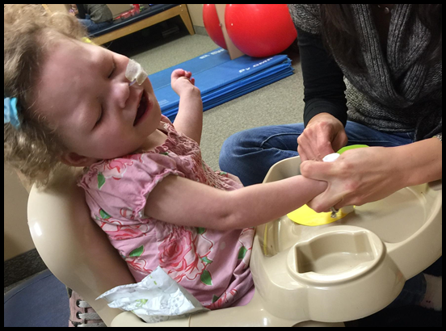
Hand Under Hand (1 of 2)
Hand Under Hand is a strategy where the learner’s hands are gently guided from underneath, which allows the child to explore and participate as they choose.
Hand Over Hand as a teaching strategy is passive from the learner’s perspective, often aversive, and may not respect the learner’s preferences.

Slide 19
Hand Under Hand (2 of 2)
Access to ways people use hands
Provides spatial awareness through tactile experience
Encourages authentic involvement
Stimulates curiosity
Preparation for tactile signing
Notes:
Allows the student access to the ways people use their hands. The student can experience hands in relation to one another, including direction of movement, amount of force, speed or tempo. (We take this for granted!)
Provides a person who is blind or has low vision with spatial awareness through tactile experience.
Encourages authentic involvement of the student in routine tasks that they cannot yet perform independently.
Stimulates curiosity about what’s around them & increases the desire to do things for themselves, reducing passivity and dependence. If the student’s hands are on top of the adult’s hands, the student makes the choice of moving with that person’s hands, thus requiring active learning on their part.
Prepares for tactile signing by teaching the student to learn to reach for communication.

Slide 20
Wait Time (1 of 2)
Children with deaf-blindness need more time to process information
Amount of wait time depends on child’s physical challenges and communication level
Consider the pace of your interactions
In most cases – SLOW DOWN!
Illinois, Project Reach 2010

Slide 21
Wait Time (2 of 2)
Pause within a familiar routine
Watch for anticipation of the next step
Watch for movement, body posture, facial expression, gestures and vocalizing to indicate desire to complete an activity
Illinois, Project Reach 2010

Slide 22
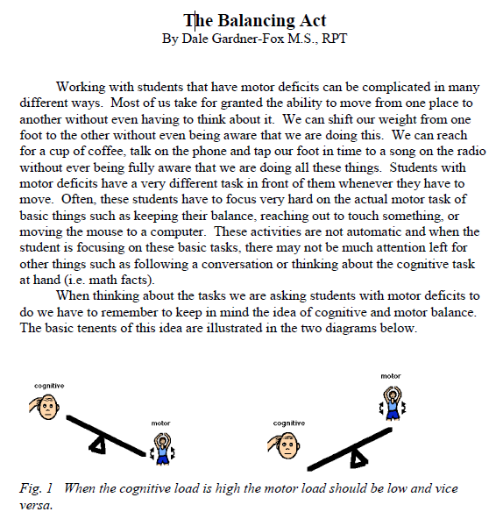
Balancing Act

Slide 23
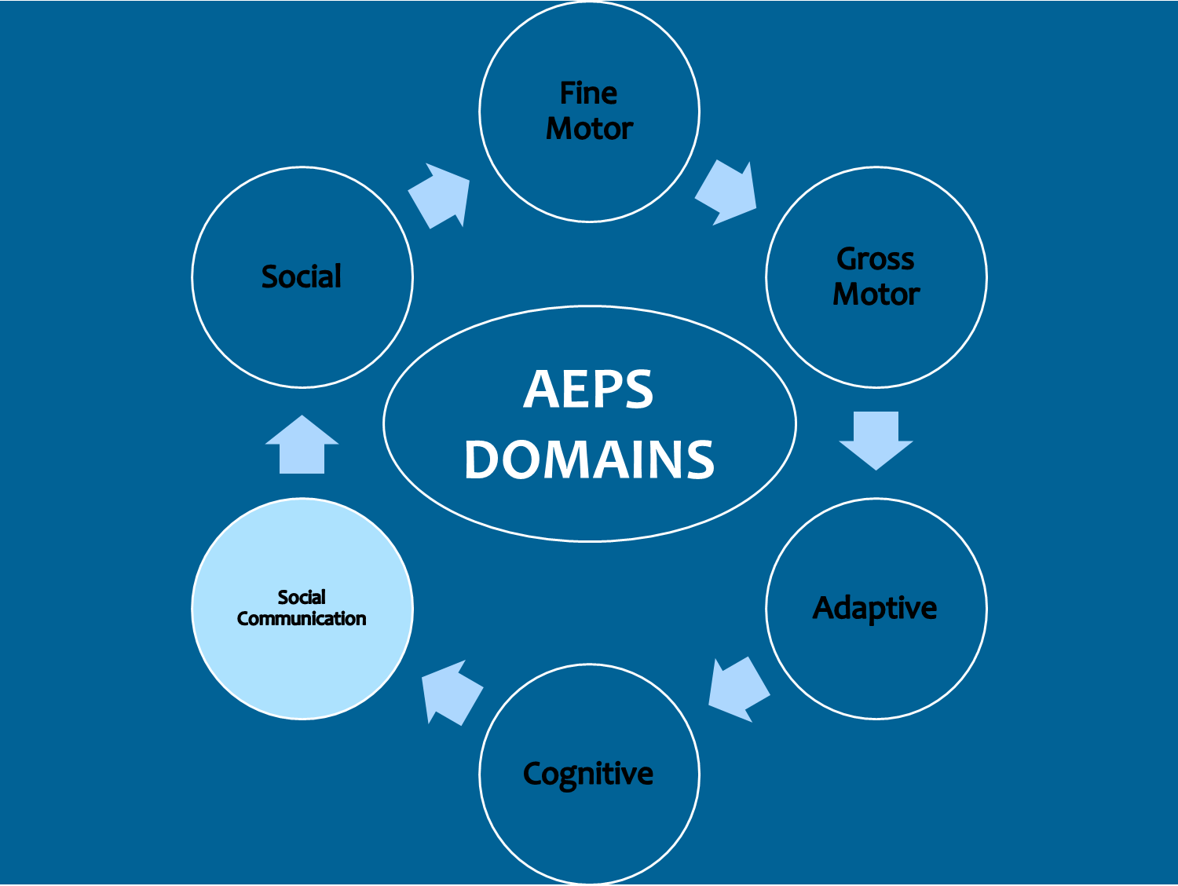
AEPS Domains
Six circles arranged in a circle around “AEPS Domains”, with arrows in between them pointing clockwise. The six circles say Fine Motor, Gross Motor, Adaptive, Cognitive, Social Communication, and Social. Social Communication is highlighted.

Slide 24
Impact on Social-Communication Skills
Miss non-verbal communication
Motor challenges
Limited communication partners
Sense of isolation
Inconsistent communication styles
Fatigue

Slide 25
How can we help improve social-communication skills?
Understand communication basics
Engage in non-traditional “conversations”
Accept, acknowledge & respond to all attempts
Provide opportunities
Use agreed upon methods consistently (across settings and by all team members)
Notes:
Allow the child to direct conversations about their topic (follow their agenda, not yours)
Incorporate rhythm, music, finger plays and mime games into daily routines and activities

Slide 26
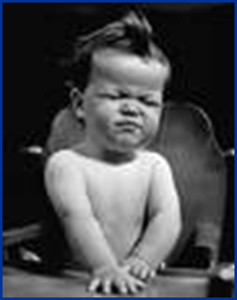




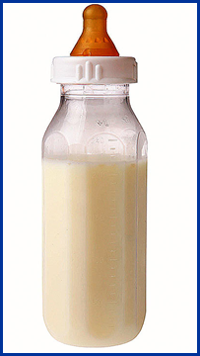


Elements of Communication
Receiver
Sender
Means of Expression
Topic

Slide 27
What do children need to build early social-communication skills?
Someone to “talk” to (partner)
Something to “talk about” (topic)
Reason for communication (function)
Method of communicating (form)
Someone to
  Interpret and respond
  Shape non-intentional and pre-intentional behaviors
Notes:
Have frequent conversations with the child (may or may not use spoken language)
Be responsive
Pre-intentional behaviors are reactions to pleasant or unpleasant sensation.
The child may whine or turn her head but doesn’t think it will bring mom running.
May swat at something but doesn’t think: “mommy will give it to me”.

Slide 28
What kind of environment expands social-communication development?
Trusted communication partners
Responsive adults & meaningful activities
Interaction with objects and people
Opportunities to
  Make choices
  Request objects or activities
  Work or play with another child
  Ask for help
  Express feelings and preferences

Slide 29
What does a communication partner do?
Always identify yourself
Use child’s preferred communication methods
Expect, wait for & acknowledge any attempt
Provide opportunities for turn-taking
Allow child to make choices
Use communication for a variety of purposes
Notes:
Already mentioned – so again, it must be important; especially the acknowledgement piece – nobody’s going to continue to try to communicate if there’s no indication that the other person knows they said something
Oh – you want ______ (just like we do for typically developing children)
Our learners won’t get it if we don’t
Encourages communication, provides opportunity for control, first step toward self-determination
And be sure it’s two-way – listen/watch for what the learner is telling you:
Getting attention, requesting something wanted, refusing something unwanted
Social interaction
Getting or giving information; give instructions (usually us doing these)
Making comments about things; express feelings
Ask questions
Conversation boxes – or “memory” boxes
For a child with no vision, a “memory box,” or a series of “memory boxes,” can be made by saving objects associated with meaningful activities. A leaf, a stone, or a twig can bring back a memory of a walk in the park; a shell can help recall a trip to the beach; a straw, a cup, or a napkin can recall a meal in a restaurant, and so on. Bringing these things home or back to the classroom in a pocket, and keeping them in a box, can serve as a kind of diary. The box can become the source of many enjoyable conversations and is a real beginning of literacy.

Slide 30
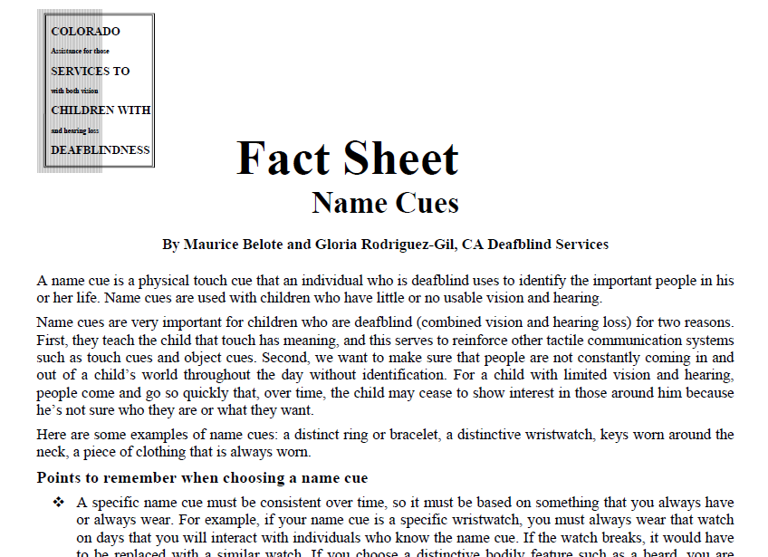
Name Cues

Slide 31
How can communication partners facilitate continued improvement?
Integrate communication into routines
Put meaning to actions and provide vocabulary
Introduce new vocabulary
Expand vocabulary related to routines & activities
Teach concepts associated with routines
Pair words with objects or symbols from the next category on the Symbol Hierarchy
Use “conversation boxes”
Introduce new communication partners/topics
Notes:
Already mentioned – so again, it must be important; especially the acknowledgement piece – nobody’s going to continue to try to communicate if there’s no indication that the other person knows they said something
Oh – you want ______ (just like we do for typically developing children)
Our learners won’t get it if we don’t
Encourages communication, provides opportunity for control, first step toward self-determination
And be sure it’s two-way – listen/watch for what the learner is telling you:
Getting attention, requesting something wanted, refusing something unwanted
Social interaction
Getting or giving information; give instructions (usually us doing these)
Making comments about things; express feelings
Ask questions
Conversation boxes – or “memory” boxes
For a child with no vision, a “memory box,” or a series of “memory boxes,” can be made by saving objects associated with meaningful activities. A leaf, a stone, or a twig can bring back a memory of a walk in the park; a shell can help recall a trip to the beach; a straw, a cup, or a napkin can recall a meal in a restaurant, and so on. Bringing these things home or back to the classroom in a pocket, and keeping them in a box, can serve as a kind of diary. The box can become the source of many enjoyable conversations and is a real beginning of literacy.

Slide 32
Using Cues & Symbols

Slide 33
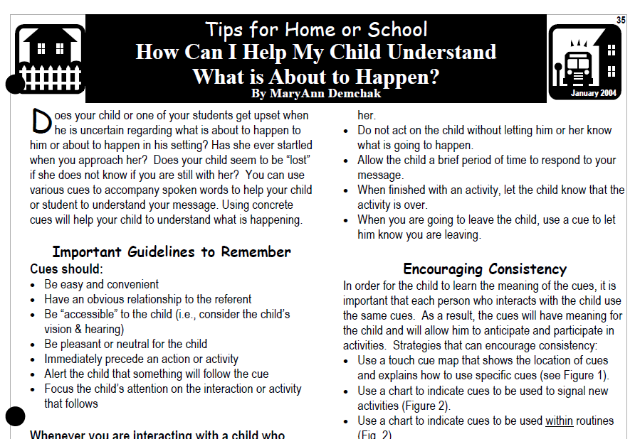
Using Cues to Help Children
Understand What Happens Next

Slide 34
Systems for Receptive Communication
Tactile Cues
  Touch Cues
    Specific signals that are executed on the child’s body
    Object Cues
      Everyday objects that are presented to the student as cues and that may be touched on the body
Notes:
Touch Cues
Help develop communication skills
Most often used with individuals at early stages of the development of communication (preintentional and emerging intentional communication skills)
Child needs to have or be working on anticipation skills – ability to make an association between the cue and the even that follows

Slide 35
What is the purpose of Touch Cues?
Specifically for receptive communication
Used immediately preceding an action or activity
To alert child that something will follow the cue
Made directly onto child’s body
Made same way each time by every person who uses them with child
Notes:
Can provide information or give a directive
Used to focus the individual’s attention on the interaction or event that follows
Used to help the individual begin to anticipate what will follow and begin to make associations of meaning between the cue and the event or action
Made with the expectation of a response from the individual, perhaps not initially, but after repeated cuing over time
Choosing cues
Must be different enough from one another that child can easily discriminate among them
Associated with a coming activity or event as much as possible
Use movements as specific as possible
Important considerations
Wait time
Motor abilities
Can make life easier for everybody (e.g. holding up arm to put into shirt)

Slide 36
How do Touch Cues help?
Reduce startling
Develop anticipatory responses
Can communicate a directive
Help children make sense of their day
Provide clearer information about expectations
Notes:
Nobody likes surprises!
Need to observe over time as child receives cue – Beginning to respond as expected? Beginning to anticipate what will happen next?

Slide 37
What does ability to anticipate tell us?
Child understands your message
How much wait time to allow
Cognitive processing is taking place
  Child remembers previous event
  Remembered and recognized your signal
  Made an association between two actions
He or she is ready for more!
  May demonstrate readiness for event
  May try to assist or engage more fully
Notes:
Great to point out to family
Shows potential for learning
One of those tiny steps of progress that are so hard to recognize

Slide 38


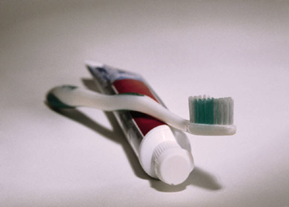
Symbols
Activity
Concrete Symbol
Abstract Symbol
Abstract Symbol
Concrete Symbol
Brush your Teeth

Slide 39
Symbol Hierarchy
Identical Object
  Partial or associated object
    Object with 1 or 2 shared features
      Photos
        Picture symbols
          Print/Braille
            Words/Signs
Notes:
Object: toothbrush/tooth paste
Partial Object: part of the toothbrush
Object with shared features: therma form in the shape of a toothbrush

Slide 40
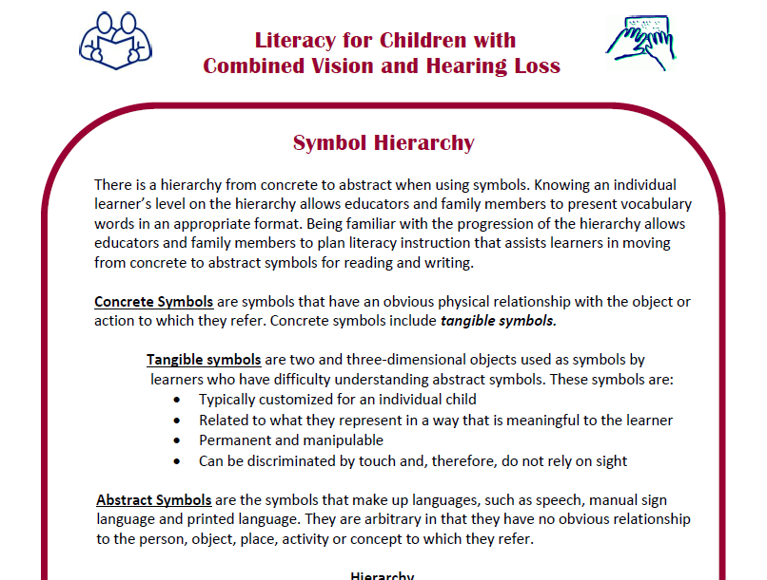
Symbol Hierarchy Article

Slide 41
Tangible Symbols
Can be touched or manipulated
Have a clear relationship to the referent (people, places, objects, activities, concepts)
Are permanent
Indicated through a simple motor response
Rowland & Schwiegert (2000). Tangible Symbol Systems. Oregon. Designed to Learn Products.
Notes:
Discuss why we use tangible symbols

Slide 42
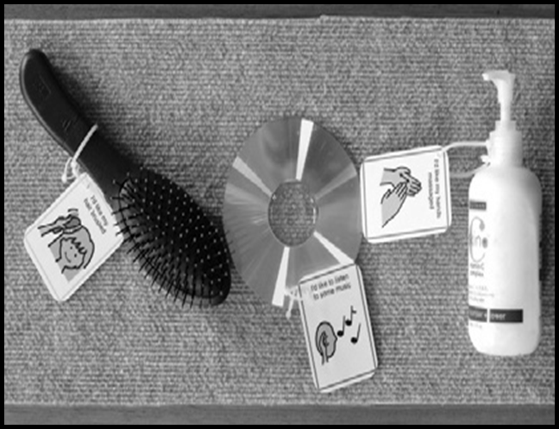

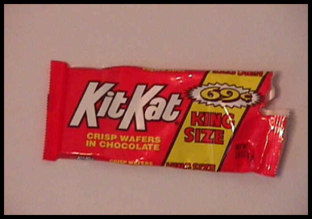
Tangible
Symbols
Picture Symbol
Objects Paired with Picture Symbols
Photograph

Slide 43
Abstract Symbols
Abstract symbols have no physical
connection to the object they represent
  Examples: Speech, Sign Language, Print or Braille words

Slide 44
What is the purpose of Object Cues?
Provide concrete information or directive
Allow student to prepare for transition to and participation in new activity
Help form accurate notion of what is to occur
Develop an expectation of what’s next
Helps child develop sense of autonomy
Can later be used for making choices
Rowland & Schwiegert (2000). Tangible Symbol Systems. Oregon. Designed to Learn Products.
Notes:
Similar to tactile cue, but moving along the hierarchy (now using a concrete tangible symbol)
Based on consistency and predictability
Used to focus the individual’s attention on the interaction or event that follows
Strategies & practices that facilitate smooth transitions are welcome by EI providers!
We all function better when we know what’s coming and can prepare for it
Provides a sense of control & autonomy (components of self-determination) when we understand & can anticipate daily events
Important considerations
Wait time
Motor abilities

Slide 45
Types of Object Cues
Actual Object
Partial or Associated Object
Arbitrary Object Cues

Slide 46
Actual Objects
Used initially to introduce object cues
Object presented to child and time given to explore cue
Keeping object during activity reinforces association to activity
Consistency & repetition continue to reinforce association
Once association is clearly established child can move to use of partial/associated object
Can also be used to introduce other objects in same category (e.g. metal spoon, serving spoon)

Slide 47
Examples of Actual Objects
Spoon or section of g-tube = EAT
Diaper = TIME FOR CLEAN DIAPER
Washcloth = BATHTIME
Stroller = GO OUTSIDE
Tactile ball = THERAPY
Blanket = BEDTIME
CD case = MUSIC

Slide 48
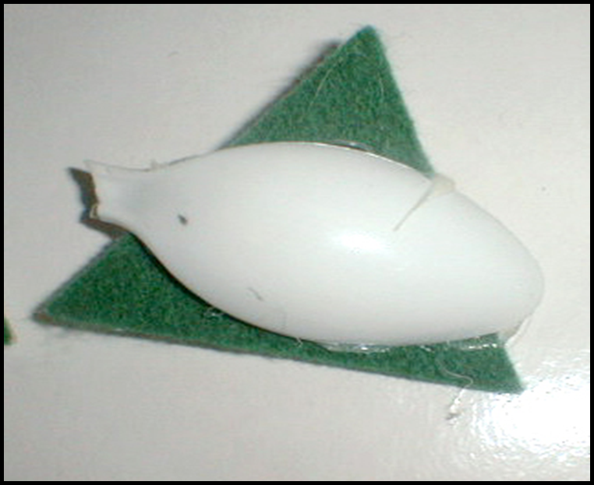
Partial or Associated Object Cue

Slide 49
More Examples of
Partial/Associated Object Cues
Piece of seat belt = GO IN CAR
Tile square = BATHTIME
Piece of diaper = TIME FOR CLEAN DIAPER
Plastic clasp from stroller = GO OUTSIDE
Bumpy fabric = THERAPY
Piece of blanket = BEDTIME
Knob from CD player = MUSIC

Slide 50
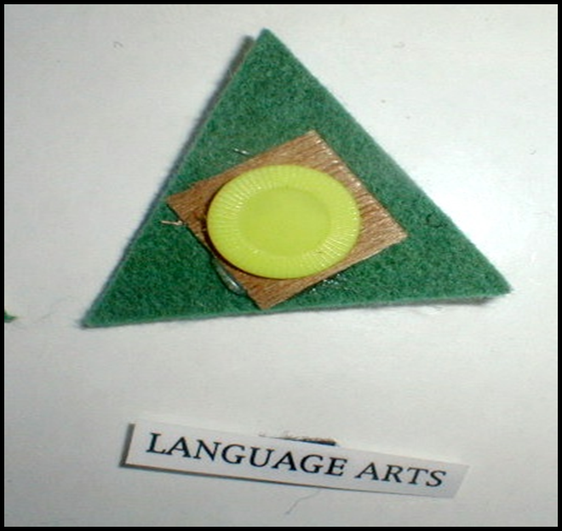
Arbitrary Object Cue

Slide 51
How do we select object cues?
Most significant from child’s perspective
Not aversive or distracting
Labeled for others to understand
Age-appropriate
Durable and easily duplicated
Tactually different
Notes:
Makes sense to child (e.g. for bus – seatbelt vs toy bus, backpack vs. picture of day care)
Variety of symbols – can use symbols at different abstraction levels
Able to differentiate symbols from others being used throughout day

Slide 52
What should be considered when selecting photograph & picture symbols?
Size, color, and shape
Visual Clutter
Glare
Background color (contrast)
Way to highlight symbol

Slide 53
How can we facilitate consistency?
Post a list of steps in the cuing routine
Model cues for all potential communication partners
Identify & share specific nature of response expected from the child
Observe delivery of cues & child responses
Monitor & collect data on deliver & responses
Communicate among team members if changes are needed

Slide 54
What is a Communication Dictionary?
Guide to child’s communication systems
Expressive and receptive
Includes all modes used by child
Don’t forget subtle non-verbal signals
Facilitates consistency across communication partners
Eases transitions to new settings, teachers, other communication partners
Notes:
Includes
Introduction on how to use it
Modes (e.g. may include picture cues, touch cues, gestures or signs)
List of tangible symbols (e.g., photos/line drawings, object cues, etc.) and their meanings
List of touch cues used and their meanings.
List of various communicative behaviors, their meanings, and appropriate responses to be made by people supporting learner
List of all signs used-with a picture or drawing of making the sign

Slide 55
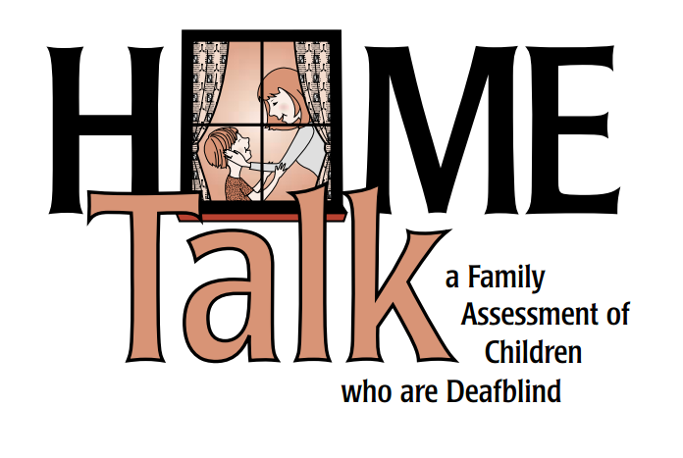
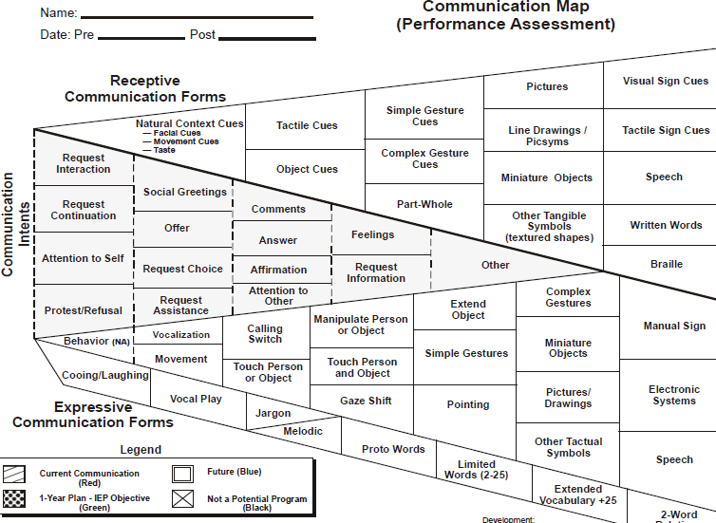
Communication Resources

Slide 56
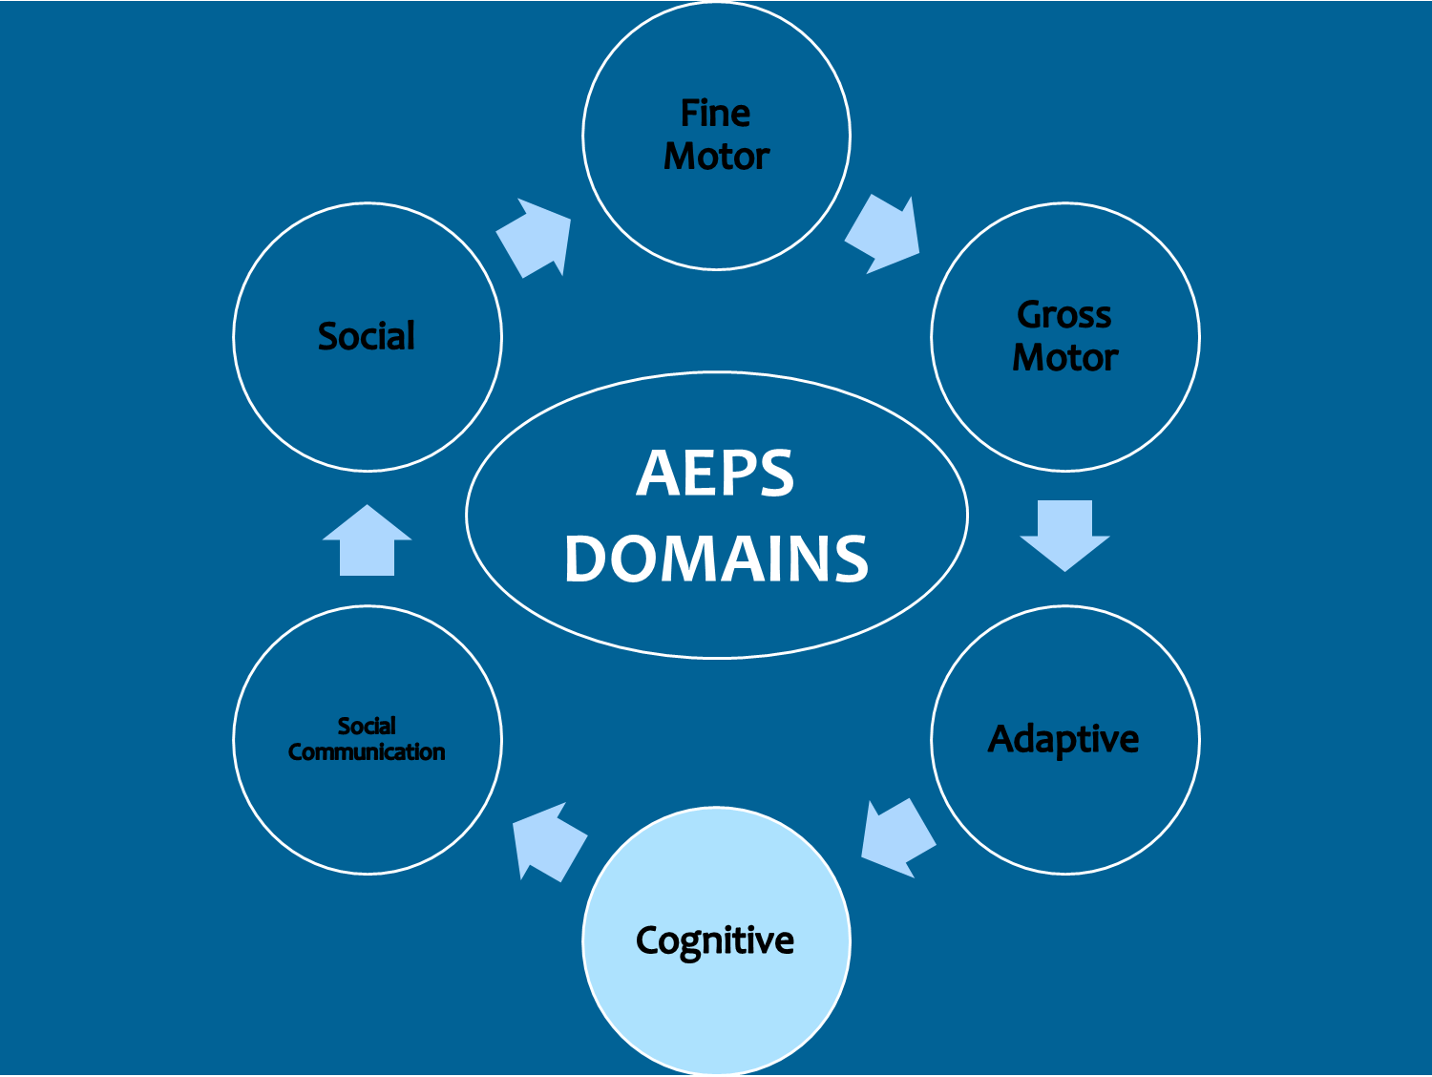
AEPS Domains - Cognitive
Six circles arranged in a circle around “AEPS Domains”, with arrows in between them pointing clockwise. The six circles say Fine Motor, Gross Motor, Adaptive, Cognitive, Social Communication, and Social. Cognitive is highlighted.

Slide 57
Impact on Cognitive Skills
Lack of access
Limited incidental learning
Perceive world differently
Concept development is challenging
Generalization is difficult
Must rely on concrete learning strategies

Slide 58
Cognitive Milestones Affected
Object/person permanence
Cause-effect
Imitation
Problem-solving
Independence in daily activities
Notes:
To know an object exists even when out of sight child must first understand concept that objects & people exist; pre-requisite to object/person permanence. Attempting to teach object permanence to a child who cannot see or hear objects /people when they are present poses unique challenge.
Infants and young children with intact vision and hearing discover quickly that actions have consequences. When vision and hearing are compromised child is likely to be unaware that her actions have caused a particular action or response.
Ability to be imitate in order to learn and practice a new skill a child must be able to see and hear person they are imitating. Combined vision and hearing loss interferes with the ability to do that and alters a child’s ability to imitate movement, sounds, actions and words in the same way as other children. A tactile approach that involves modeling and repeated opportunities for practice will be necessary.
Without visual and auditory information problem solving is challenging. It is important, however, to provide opportunities for problem-solving in order to facilitate generalization of skills and foster independence. Providing such opportunities requires making sure child has pre-requisite skills and structuring environment for learning and success rather than frustration. As EI providers, you must always look at a situation from the child’s perspective. Physical and social environment can be set up in ways that encourage problem solving; however, it is imperative that you not throw child a loop unless trust has been established and that there is a way to process the experience as and/or after it happens.
Children with combined vision/hearing loss depend on others to access the world around them so often have fewer opportunities to do things on their own. EI providers have a unique opportunity to teach families early on the value of fostering independence in everyday routines and activities.

Slide 59
How can we improve cognitive skills?
Keep expectations high
Establish predictable routines
Create responsive environments
Focus on experiences that are relevant and interesting
Plan ahead about words and concepts to focus on
Provide hands-on experiences
Use systematic instruction strategies
Allow children to make choices, take risks and learn from mistakes
Notes:
Involve child from beginning to end
Need to provide child with repeated involvement and experiences
Use hand under hand techniques, especially when introducing new activities

Slide 60
Responsive Environments
Designed to encourage exploration and assist in development of
Visual memory
Cause/effect
Object permanence
Properties of objects (weight, size, temperature, texture, sound, color…)
Notes:
Use different ones than in motor skills
UseSpaces for Active Learning
http://www.wsdsonline.org/deafblind/space/index.html
Resonance Board
Allows child to receive additional sensory input as child feels vibrations associated with movement
http://www.wsdsonline.org/deafblind/resonance/res-overview.html

Slide 61
Systematic Instruction
Using the same words, actions and consequences over and over on a continuous basis to teach a specific skill

Slide 62
Examples of Systematic Instruction
Task Analysis
Cues and Prompts
Wait time
Shaping, Fading, Pairing
Discrete trial technique
Consistency and Repetition

Slide 63
Task Analysis
Choose task
Determine steps for task
Determine order of instruction for student (e.g. full task, backwards chain)
Complete tasks during routines and document completion of steps
Modify steps as needed
Project Reach 2010

Slide 64
Shaping
Teaching of a new behavior by reinforcing successive approximations of the behavior
  Reward any response at first
  Reward responses that resemble the desired behavior
  Reward only the targeted behavior
Project Reach 2010

Slide 65
Fading
Decreasing the level of assistance needed to complete a task or activity
  Identify the process that will be used to fade the prompt or prompts using Task Analysis
  Decrease as soon as possible to avoid prompt dependency
  Project Reach 2010
Notes:
Examples:
Learning to print by tracing letters that are solid to begin with and fade to dotted lines
Physical prompt of guiding a child’s hand:
Support wrist
Touch hand lightly
Touch forearm or elbow
Withdraw physical contact all together

Slide 66
Pairing
Two corresponding items, similar in form and/or function matched and associated.
  Introduce an unknown, unfamiliar or less preferred item along with a known or preferred item.
  Use fading to replace the familiar item with the new one.
Examples
Braille word on label paired with concrete object
Oatmeal paired with yogurt
Sponge Bob pillow with more age appropriate item
Project Reach 2010

Slide 67
Concepts
How we connect meaning to objects, events and people
Foundation for literacy and abstract learning
Categories
  Concrete
  Semi-concrete
  Abstract
Notes:
Concepts are the ideas that give meaning to our world.
We develop concepts based upon our particular experiences.

Slide 68
Concept Development (1 of 2)
Concept development is not same as
skill development
    A concept is a mental representation, image or idea of tangible and concrete objects (such as chair or dog) and intangible ideas and feelings (colors or emotions)
    A skill is the ability to do something (such as tying a shoe, using vision to find an object)
Notes:
Since concept development is one of the most critical areas related to learning for children with deaf-blindness we will begin there.

Slide 69
Concept Development (2 of 2)
Concepts can be divided into three groups
  Concrete concepts relate to objects or things that are tangible
  Semi-concrete concepts relate to an action, color, position, or something that can be demonstrated but not held in one’s hand (jumping, behind, red)
  Abstract concepts include feelings (love, nervousness, patriotism).
Project SPARKLE, 2006
SKI-HI Institute, Utah State University
Notes:
This slide lists the three categories of concepts and describes each.

Slide 70
Concepts affected by combined vision & hearing loss
Objects exist
Objects have permanence
Objects differ
Objects have names or labels
Objects have characteristics
Objects have functions or use
Project SPARKLE, 2006
SKI-HI Institute, Utah State University
Notes:
Sighted & hearing children receive constant flow of visual and auditory information which facilitates development of concepts. For children with CVHL loss, flow of information is incomplete. Concepts don’t develop naturally or easily. There are certain areas of concept development that are particularly affected by deafblindness.
Objects exist: Difficulty learning about existence of objects because cannot see or hear objects clearly; world may be a place of darkness, shadows, silence or muffled sounds; may be difficult to distinguish actual presence of an object or know where one object stops and another begins.
2. Objects have permanence: Can’t observe objects/people at a distance and know that things exist beyond their fingertips; For these children there may not be any, or much, of a world beyond what the child can reach out and touch. They are not aware that the toy just played with is still part of their world once it’s placed back on the toy shelf – or that a family member is still in the room with them once that family member has gone to the other side of the room to sit down.
3. Objects differ: Won’t know one object is different form another unless can touch and explore them
When vision is absent or limited details are missed. Items near may look similar to items further away making it difficult to distinguish size differences.
4. Objects have names or labels: Need to use touch to support language learning; isn’t enough just to say or sign name or description of an object. If
child can’t touch and feel it there is no way to connect the word to the object.
5. Objects have characteristics: Difficulty identifying characteristics of objects because of lack of access to information about those objects. Even
without vision or hearing loss a child needs repeated experience over time with various kinds of objects to learn about characteristics such as size, weight,
temperature and texture. These children need much, much more.
6. Objects have functions or use: Can’t observe how objects are used, or hear the sounds associated with functions of objects; difficult to integrate
experiences and make connections; important to adopt a “hands-on” learning approach so that children can be involved from beginning to end in
everyday activities.
All but last one are concrete (and none are abstract) – so you see why working on concept development is key for these children

Slide 71
How do we facilitate concept development?
Adopt a hands-on, holistic approach
Attach language to all experiences
Build on vocabulary already known by child
Use a total communication approach that is appropriate for the child
Remove variables that may cause confusion for the child
Generalize concepts to varied situations
Consistency among team members

Slide 72
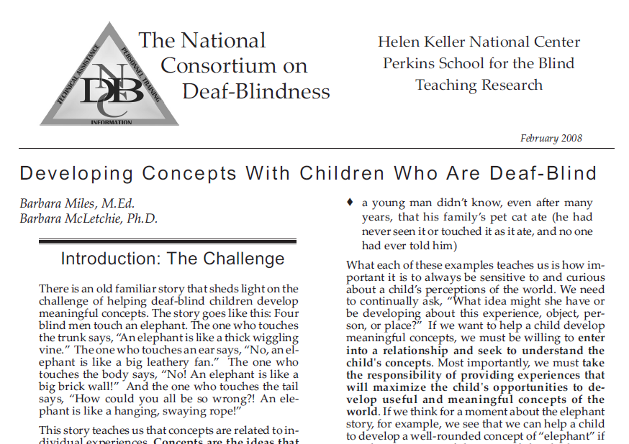
Developing Concepts

Slide 73
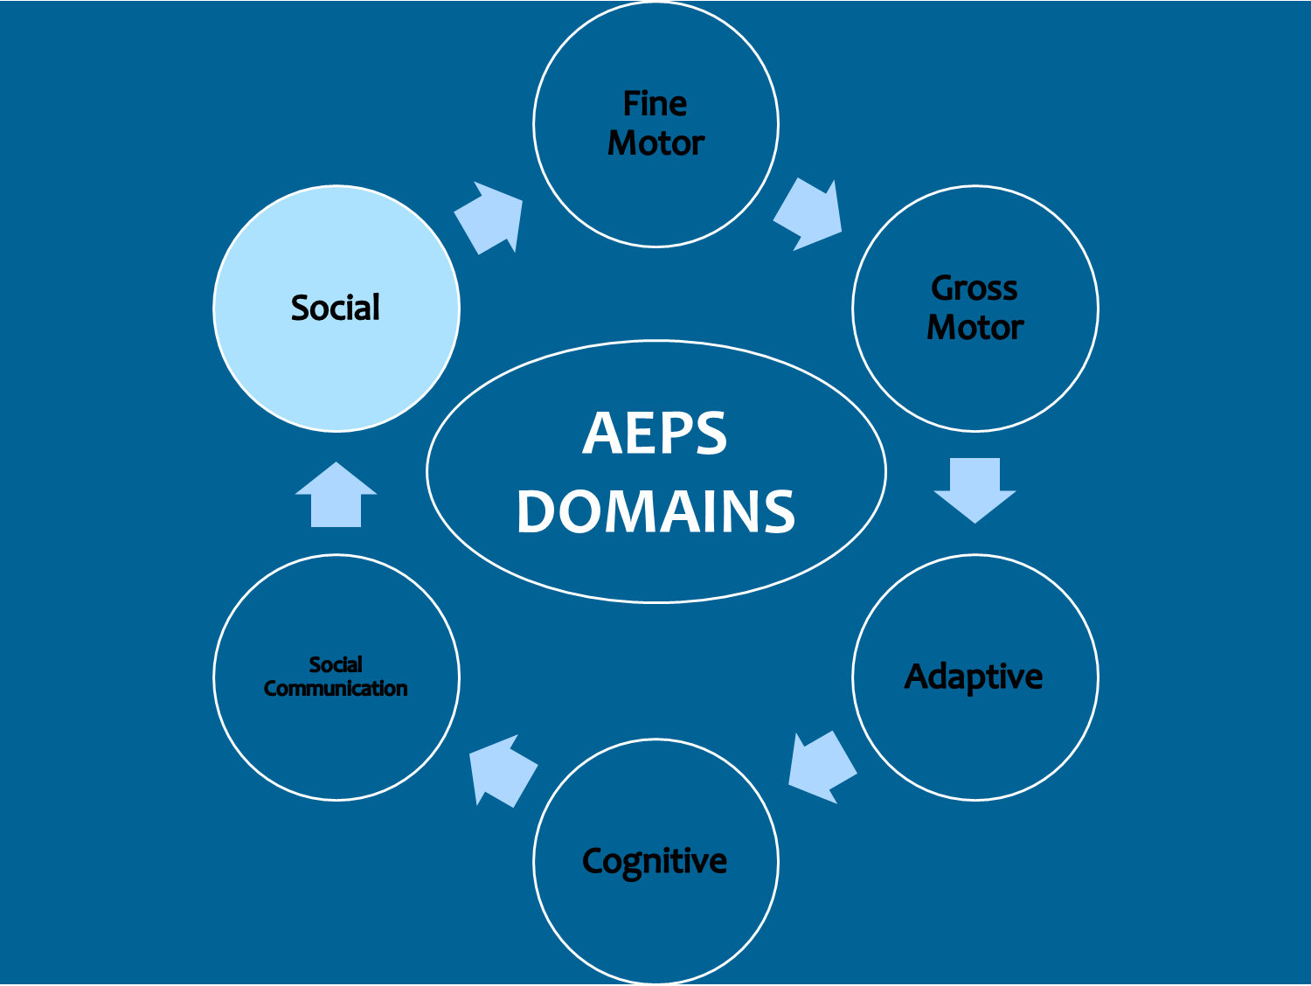
AEPS Domains - Social
Six circles arranged in a circle around “AEPS Domains”, with arrows in between them pointing clockwise. The six circles say Fine Motor, Gross Motor, Adaptive, Cognitive, Social Communication, and Social. Social is highlighted.

Slide 74
Impact on Social Skills
Limited access
Lack of communication partners
Miss visual & auditory information
Mobility & heath issues interfere
Non-conventional interactions may be misunderstood
Fatigue

Slide 75
How can we help improve social skills?
Build & expand relationships
Teach names of family & friends
Provide partners for communication and social interaction
Facilitate participation
Follow the child’s lead
Be responsive
Remember to PLAY!
Notes:
Do things the child enjoys
Complete or partial
Assistive technology
All potential communication partners should have a unique personal cue to identify themselves to the student
This should be used each time when greeting student and leaving student
Mikayla book

Slide 76
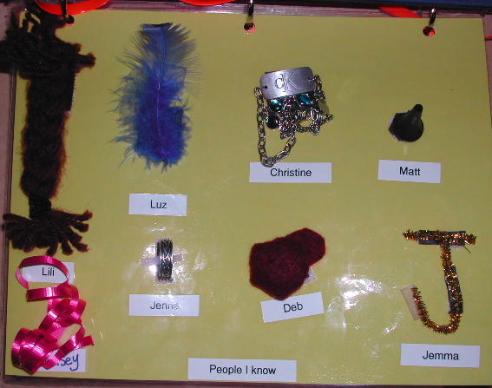
Examples of Name Symbols
Notes:
Also talk about greeting rituals

Slide 77
How can we help children engage in social activities?
Develop a “greeting ritual”
Use assistive technology
Adapt environment, equipment & materials
Provide secure base from which to explore & participate
Support child in partial participation
Use task analysis to identify skills needed for full participation
Notes:
Greeting ritual – cue, game, touch – teach child to use it in community, with siblings, friends, less familiar adults

Slide 78
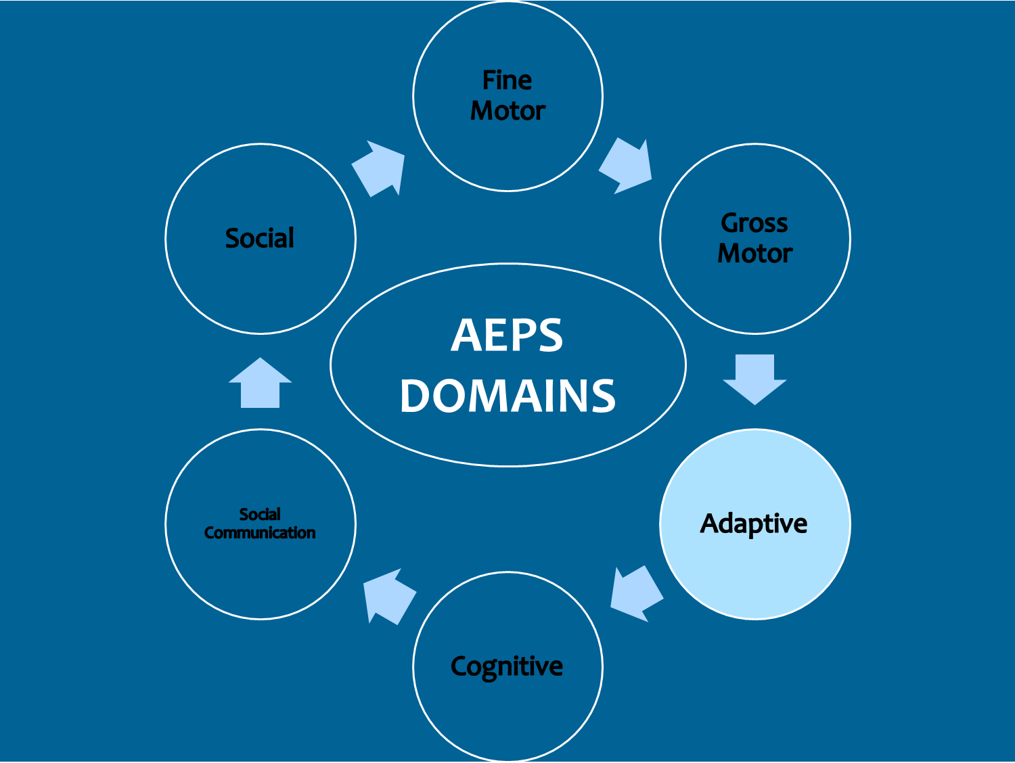
AEPS Domains - Adaptive
Six circles arranged in a circle around “AEPS Domains”, with arrows in between them pointing clockwise. The six circles say Fine Motor, Gross Motor, Adaptive, Cognitive, Social Communication, and Social. Adaptive is highlighted.
Notes:
Familiar with this
Will look at each domain, impact of multiple disabilities, vision/hearing loss, provide strategies to enhance learning in that domain
AEPS provides team with vehicle for identifying not just what child can/cannot do, but conditions under which the child can/cannot do those things; that’s important for the children we’re talking about

Slide 79
Impact on Adaptive Skills
Limited awareness of everyday activities
Expectations may be lower
Challenges with concept development
Fatigue

Slide 80
How can we help improve adaptive skills?
Involvement in daily household activities
Develop routines
Consistency & repetition
Support partial participation initially
Use scaffolding to increase participation
Provide opportunities to make choices
Keep expectations high
Create calendar systems
Notes:
Do things the child enjoys
Complete or partial
Assistive technology
All potential communication partners should have a unique personal cue to identify themselves to the student
This should be used each time when greeting student and leaving student
Mikayla book

Slide 81
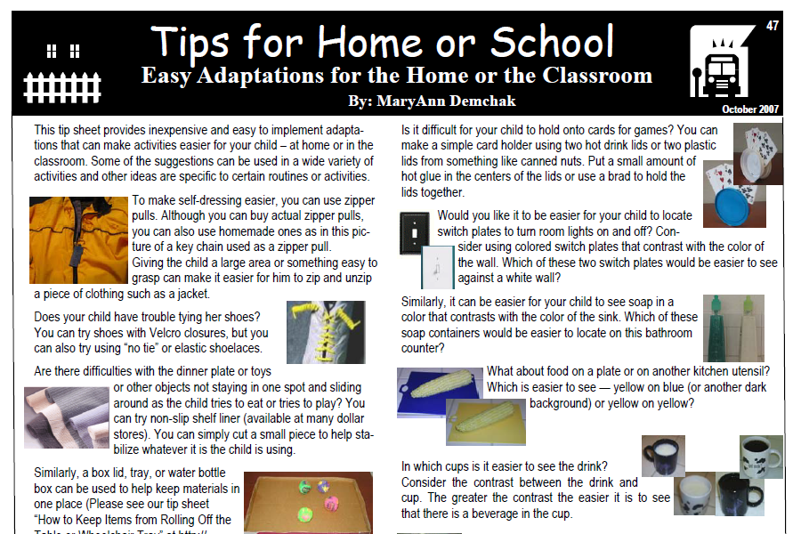
Adaptations

Slide 82

Calender Systems
Anticipation schedules
Daily schedules
Weekly, Monthly or Annual calendars
Notes:
Anticipation Calendar
An association is built between the activity and a particular object
The object is used to represent the entire activity
Provides the child and communication partner with a mutually understood topic
Introduces the time concepts of past and future
Provides a sense of security because the child knows what will happen next
Can address unexpected changes in routine

Slide 83
What is an Anticipation Schedule?
Introduction to calendars
Represents a single activity
Develops understanding that activities can be represented by symbols
Can explain changes in a routine, activity or schedule
Provides sense of security
Introduces concepts of past & future
Notes:
-child seems to anticipate next step in a routine – shows a change in affect
-begin with highly motivating activities to build concept of anticipation – present symbol close to time that activity is occurring and close to activity – gradually increase distance and time

Slide 84
How do you create an Anticipation Schedule ?
Need two distinctive containers
  One for “NEXT”
  Another for “FINISHED”
Present object close (in time and space) to activity to build association
Post written list of what each object represents
Can be expanded to show 2-3 activities

Slide 85
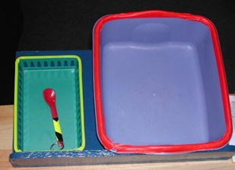
Anticipation Schedule – Example 1
Actual object
represents activity
“Finished”
bucket
Colored electric tape delineates edges and draws attention to object

Slide 86
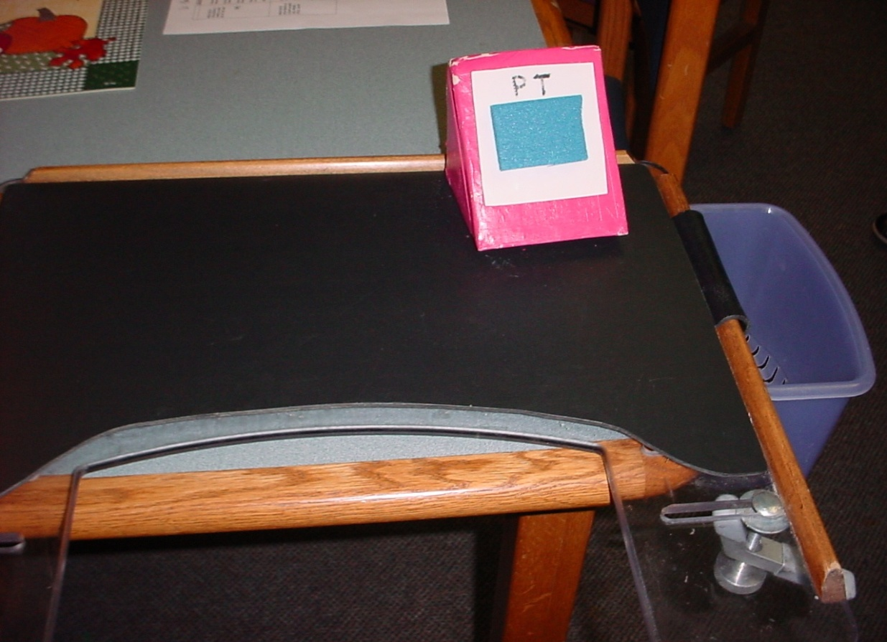
Anticipation Schedule – Example 2
(1)
Adapted for limited range of movement
(1) Tactile symbol mounted on lightweight wedge
(2) Finished bucket is attached to side of wheelchair tray
(2)
Notes:
S with limited range of movement – on slant – easily removed – finished box is attached to tray – stable and sturdy

Slide 87
What are the components of a
Calendar System?
Set of symbols representing activities
Format for sequencing the symbols
Routine for presenting and using the symbols
Time built in for communicating about activities
Accessible storage place for symbols

Slide 88
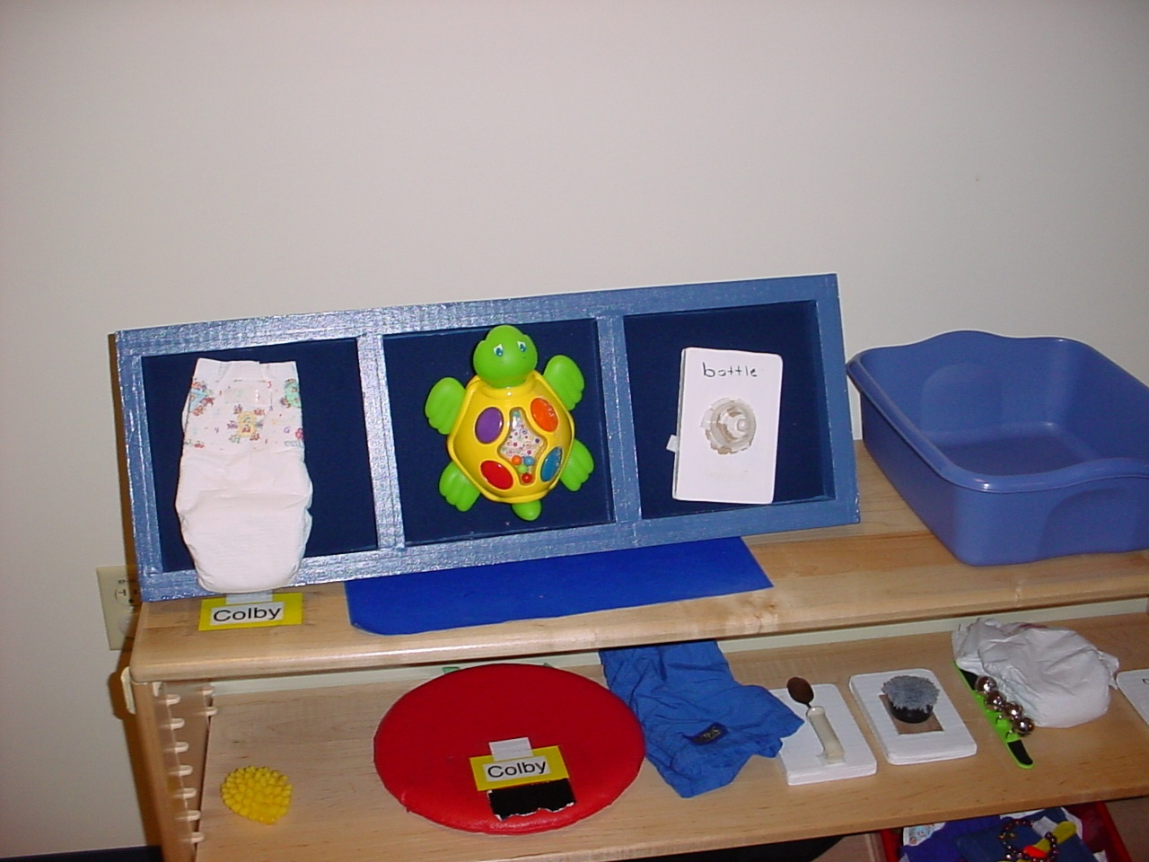
Daily Schedule – Example 1
Dishpan for “finished”
Symbols for three activities – Changed throughout day
Storage under schedule for additional objects
Introducing child’s name & words for familiar items
Used in preschool class; will transition with child to Kdg
Notes:
S with limited range of movement – on slant – easily removed – finished box is attached to tray – stable and sturdy

Slide 89
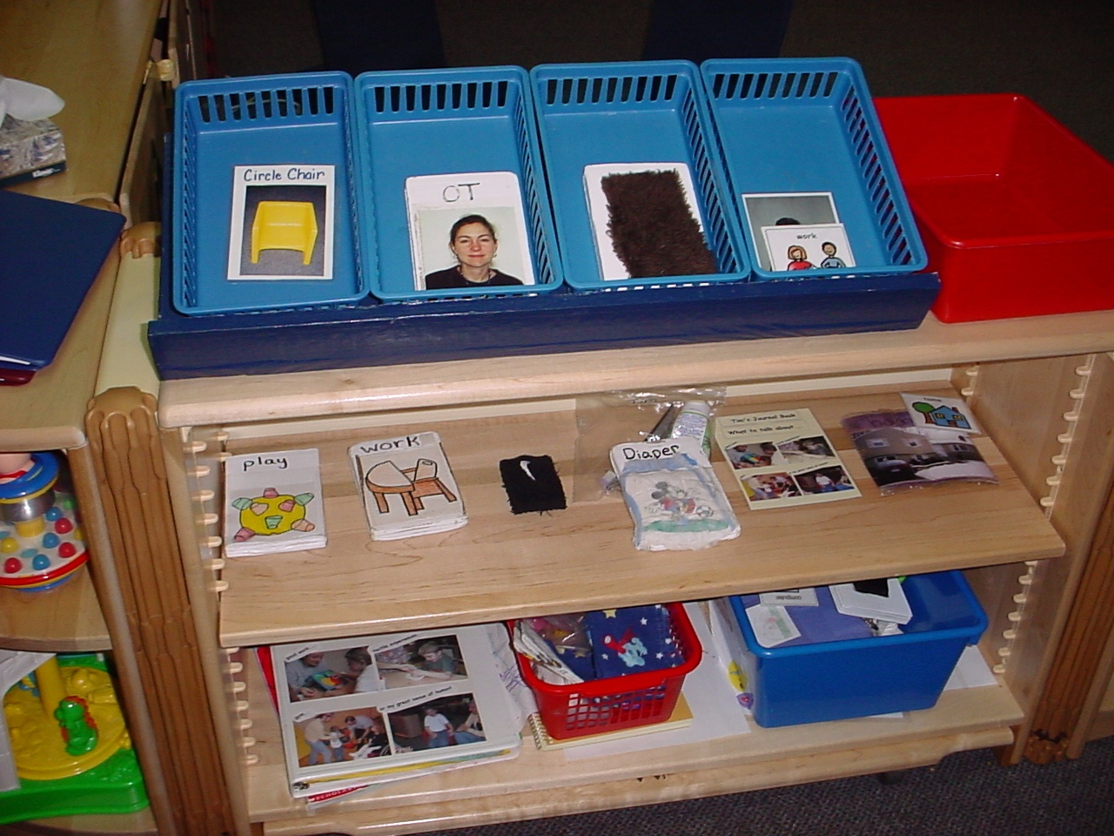
Daily Schedule – Example 2
Bins for four activities
Different colored bin for “finished”
Storage under schedule for additional symbols
Uses partial objects, tactile symbols, photos, line drawings and print
Notes:
S with limited range of movement – on slant – easily removed – finished box is attached to tray – stable and sturdy

Slide 90
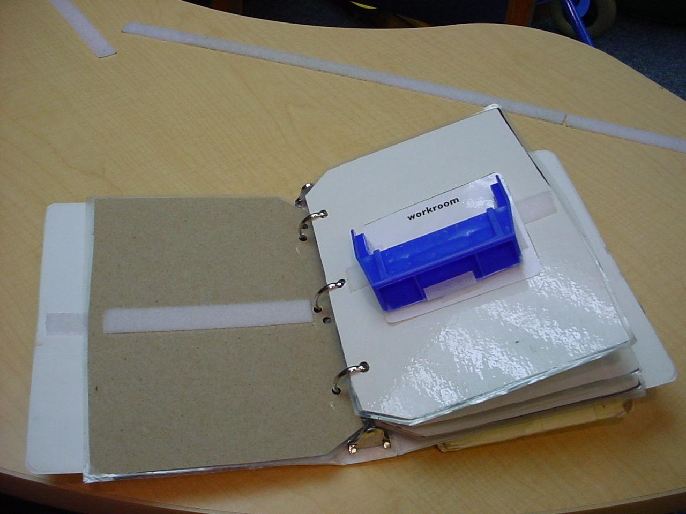
Portable Daily Schedule
Notes:
Book format – using parts of objects – workroom – part of a bin

Slide 91
How can a calendar system help? (1 of 2)
Establish routines or patterns of expectation
Provide structure & sense of control
Lessen anxiety
Assist with transitions
Introduce time concepts & early literacy skills
Improve cognitive skills
Notes:
Pretty much the same as for us
Why? -used successfully with students who have limited vision and hearing, as well as students with autism and multiple disabilities
-instructional tool to:
- give information to students about daily schedules
- to promote representational concept development
- to provide a means of making choices about activities and events
-for DB Ss, world can often seem confusing and inaccessible - auditory and visual information may be limited, distorted, or unavailable - essential that time and events are clearly structured and represented in concrete, understandable ways
-calendars used by most people to structure their time, plan for the future, and review past events
-students with sensory impairments, and others with significant disabilities, need to have predictable routines and to be given unambiguous information in order to anticipate events and more fully prepare to participate in them
-for many individuals for whom speech, visual sign language, and 2-D symbols are not communication options, the use of 3-D objects is a viable means of sharing information
Emotional: what is going to happen next? may miss natural cues related to future events
gives child things to anticipate
way to provide calm transitions
alerts child to unexpected changes in routine – can prepare
allows participation in decisions about day’s events – sense of control
eg. People dependent on Palm devices, planners (airports, etc.)
Time concepts: lacks opps to gain info re: passage of time that typical children have (eg. of waking up in morning – breakfast sounds, light; time to change classes – bell, gathering materials)
calendars are timepieces – tangible way to show passage of time
student’s memory - ability to reflect on activities which have occurred
Comm. Skills: not communication without partner and intention – calendar is a tool
time vocabulary (often very abstract): gross labels – then, now, next, finished, later
communicate about events and people out of context
make choices
use symbols
topics for dialogues – something to communicate about

Slide 92
How can a calendar system help? (2 of 2)
Increased communication opportunities
Provide topics for conversation
Improve social skills
Means of discussing activities and people out of context
Vehicle for moving from tangible objects to more symbolic representations of activities
Notes:
Fit in with others
Have things to talk about

Slide 93
How can a daily calendar help?
Begin to teach
  Order & sequencing
  Left to right orientation
  Position concepts (left to right, first/last)
  Expanded sense of future
Personal responsibility & self-determination
Save time, lessen frustration, ease transitions
Can review day using objects from finished container
Notes:
-begin to sequence activities using boxes or other format – begin with 2 or 3 – may work up to full day
-can add expansion strips to build vocabulary – add information about the activity
-eg: band: add photos/symbols for teacher, instrument, music book
Child can take part by helping set up the day

Slide 94
References
Chen, D. (Ed.). (2014) Essential Elements in Early Intervention: Visual Impairment and Multiple Disabilities. New York, NY: AFB Press.
Chen, D. with others. (2008) Early Intervention in Action: Working Across Disciplines to Support Infants with Multiple Disabilities and Their Families. CD-ROM textbook with video clips. Brookes Publishing Co.
Hatton, D, McWilliam, R, & Winton, P. (2002). Infants and toddlers with visual impairments: Suggestions for early interventionists. Eric Digest, ED473829.
National Center on Deaf-Blindness. (2008) Literacy for Children with Combined Vision & Hearing Loss. www.literacy.nationaldb.org
National Center on Deaf-Blindness. Open Hands, Open Access: Deaf-Blind Intervener Modules. https://moodle.nationaldb.org/
Petersen, B. & Nielsen, J. (2005). Vision Program: Vision Skills in the Natural Environment. Utah Schools for the Deaf and the Blind.
Scoggin, K. (2012) Identifying and Supporting Young Children with Multiple Disabilities that May Include Hearing Loss and/or Vision Impairment. Washington Sensory Disabilities Services. http://www.wsdsonline.org/training/recorded-trainings/identifying-and-supporting-young-children/
ViSioN Program available through Hope Inc. at www.hopepubl.com

